Slide 1
Module - 2

Slide 2
The 6 Types of Startups
https://www.analyticssteps.com/blogs/top-10-successful-startups-india
Contrary to popular belief, not all startups are tech companies in Silicon Valley. From lifestyle startups to social and environmentally impactful organizations, there are many types of startup possibilities.
At its origin, a startup is not a permanent business model but rather a crucial beginning stage of a business’s life.
In general, the purpose of a startup company is to create a product that targets an untapped market or improves on existing options.
The first step to launching a startup of your own is understanding the six types of startups and which is right for your business’s goals:

Slide 3
Startup Type
Startup Type 1: Scalable Startups
Startup Type 2: Large Company Startups
Startup Type 3: Small Business Startups
Startup Type 4: Social Entrepreneurship Startups
Startup Type 5: Lifestyle Startups
Startup Type 6: Buyable Startups

Slide 4
Startup Type 1: Scalable Startups
Scalable startups take an idea or concept — typically in the tech sphere — and work to rapidly grow the company’s top-end revenue to achieve the highest return on investment (ROI) possible.
This type of startup requires thorough market research to identify exploitable market opportunities.
Two of the most relevant examples of scalable startups are Google and Facebook. Both of these companies started with the intent to dominate their industry through a scalable startup model and were successful in doing so.
A Scalable Startup May Be Right for You If:
Your startup idea has an extensive market available and vast growth potential.
You’re an innovator ready to challenge the status quo.
You want to be the leader of an industry.

Slide 5
Examples Scalable Startup Entrepreneurship
There are many examples of scalable startup entrepreneurship that are given below
Facebook
Twitter
Instagram
Google,
Skype
Any Online store like amazon, flipkart
McDonald’s
Any coffee shop can be scalable like CCD
Any Lawn Business.
Household items business

Slide 6
Startup Type 2: Large Company Startups
With technology, customer interest, and markets changing every day, large companies need to adapt their business model to survive.
This is where large company startups come in.
Backed by the support and capital of the already successful company, these offshoot startups aim
to reach new audiences,
diversify product offerings, and
keep large companies tapped into the ever-changing market.
A Large Company Startup May Be Right for You If:
You already own a large, successful company.
You’re looking to diversify or tap into a new market that isn’t in your company’s current wheelhouse.
You need a way to compete with new businesses and keep up with the changing market.

Slide 7
Startup Type 3: Small Business Startups
https://www.thebalancesmb.com/best-small-businesses-opportunities-4111809
The priority of small business startups is longevity instead of scalability.
These small startup companies are built to provide enough capital for financial stability by catering to a small target market.
Common types of small business startups are family-owned and operated barbershops, grocery stores, and retail shops.
A Small Business Startup May Be Right for You If:
You plan to hire locals and family to operate your business.
You want to focus on adding to your community.
Creating a sustainable, long-lasting business is your main focus, rather than pure profit.

Slide 8
Startup Type 4: Social Entrepreneurship Startups
https://www.whizsky.com/2015/01/social-entrepreneurs-of-india/
Unlike other types of startups, social startups are not created to gain wealth for the founders;
they are created to make a positive social or environmental change.
Social entrepreneurs shouldn’t expect a big payout from their startup; however,
it is possible to make money with this startup model if it is not a nonprofit organization.
A Social Entrepreneurship Startup May Be Right for You If:
You want to build a company that will make a positive social or environmental impact.
You aren’t interested in starting a company for the profit.
You have an idea that can solve a widespread problem, specifically for disadvantaged communities

Slide 9
Startup Type 5: Lifestyle Startups
Lifestyle startups are born out of passion and desire for independence,
with the founders putting their time and energy toward making a business out of their favorite hobby or activity.
This can range from an avid traveler starting a tour guide business to a web developer starting a freelance coding business.
A Lifestyle Startup May Be Right for You If:
You have a hobby you could do all day, every day.
You’re self-motivated and disciplined enough to be your own boss.
You’re passionate and creative.

Slide 10
Examples of Lifestyle startups
Say like, a surfer who opens up shop and earns a living by giving surfing lessons. Take Mathew Jones, a former Australian Surfer on the WQS Circuit, turned full-time school teacher for instance. Mr. Jones aspired to be more than a teacher and turned his passion for surfing, fitness and wellness into, not just one, but several mobile apps.
One of his most popular iPhone apps iSurfer, which offers surfing lessons, has garnered quite a following. Or let’s assume that you’re a designing student who loves to make logos. And you’re contemplating to begin your logo maker startup

Slide 11
Examples of Lifestyle startups
Here are some of the most common examples of thriving lifestyle businesses today.
Professional blogging. This is most probably the quintessential lifestyle business. Many bloggers now make their living through blogging.
Novelists, poets, journalists… These writers prefer to take the freelance route instead of getting employment in established organizations or companies. They travel, go places, experience things and write about them.
Consultants and advisors. Services of consultants are sought after these days, ranging from matters regarding finance, law, technology, health, travel, real estate, and more.
Online stores. E-commerce also falls under the lifestyle business category if they meet the definition of one.
There is a general misconception that lifestyle businesses are strictly conducted online. That is wrong. A lifestyle business can be any kind, so it can also be offline. It may involve selling physical goods or services.

Slide 12
Startup Type 6: Buyable Startups
https://acquiredby.co/google-acquisitions/
Unlike other startups, buyable startups are not built to become billion-dollar companies;
alternatively, they are built to be sold to a larger company for millions of dollars.
Buyable startups are commonly tech-focused, and many of them are specifically in the app development industry.
A Buyable Startup May Be Right for You If:
You want to build a company but not commit to operating it long-term.
You have a startup idea with tremendous growth potential.
You’re a “serial entrepreneur.”

Slide 13

Startup_Financing

Slide 14
Entrepreneurial Motivating Factors: Internal and External Factors!
Let us address to the larger question what factors motivate entrepreneurs to start enterprises.
Many researchers have tried to understand and answer this question by conducting research studies to identify the factors that motivate people to take all the risk and start a business enterprise
While some researchers have classified the factors motivating entrepreneurs into
‘push’ (compulsion) and
‘pull’ (choice) factors,
most of the researchers have classified all the factors motivating entrepreneurs into internal and external factors

Slide 15
Internal Factors:
1. Desire to do something new.
2. Become independent.
3. Achieve what one wants to have in life.
4. Be recognized for one’s contribution.
5. One’s educational background.
6. One’s occupational background and experience in the relevant field.
External Factors:
1. Government assistance and support.
2. Availability of labour and raw material.
3. Encouragement from big business houses.
4. Promising demand for the product.
One research study (Murthy et. al. 1986) reports that entrepreneurs are motivated to start business enterprises due to the following three types of factors:
1. Ambitious factors.
2. Compelling factors
3. Facilitating factors.

Slide 16
Motivating Factors
Internal | External
Educational Qualifications | Assistance from Govt.
Occupational Experience | Assistance from financial Institutions
Desire to work independently in manufacturing line | Availability of technology/ raw-materials
Desire to branch out to manufacturing from present occupation. | Demand of a particular product
Family background | Wanted to utilise excess Money *Euzancia1 help from non- government sources.
To engage family members along with himself
To possess social prestige

Slide 17
Entrepreneurial Leadership Characteristics:
Entrepreneurial leadership involves organizing and motivating a group of people to achieve a common objective through
innovation,
risk optimization,
taking advantage of opportunities, and
managing the dynamic organizational environment.
The traditional corporate mindset has
its focus on systems and processes,
whereas the entrepreneurial style
is more risk oriented.

Slide 18
Some of the common entrepreneurial leadership characteristics are as follows.
1. Communication skills
The leader is able to clearly articulate their ideas, and the plan to achieve common goals.
They encourage communication between departments and across levels.
They avoid ambiguities and generalizations, and are able to avoid conflict and misunderstanding due to poor communication.
2. Vision
A successful entrepreneurial leader has a clear vision.
He knows exactly where he wants to go and how to get there.
They communicate their vision to the team and work with them to make the vision a reality.

Slide 19
3. Supportive - Ratan Tata
An entrepreneurial leader realizes the importance of initiative and reactiveness, and they go out of their way to provide all the support that the team needs to achieve their goals.
The leader usually does not punish employees when they take a calculated risk which misfires.
Instead, they sit down with employees to analyze what went wrong and work with them to correct the mistakes.
4. Self-belief
The leader has tremendous belief in themselves and has confidence gained from years of experimenting, at times failing, and learning.
They are aware of their strengths and weaknesses, and demonstrate their skills without hubris.
An entrepreneurial leader is very self-assured.

Slide 20
5. Shares success - Former President Dr.A.P. J. Abdul Kalamji
When the team or the organization succeeds at something, the leader does not hog the limelight or take all the credit.
They acknowledge the contribution of others and shares the accolades with them.
6. Involved - Ratan Tata ji / Narayan Moorthy
You will not find an entrepreneurial leader cooped up in the office.
Leaders like to spend time among employees, walk around the factory or department, interact with everyone, and see them doing their job.
This leader will usually take some time out to informally chat with employees, and understand their work and personal challenges.
7. Create an atmosphere conducive to growth - Google office
With a deep understanding of the importance of other people’s contribution to organizational success, the entrepreneurial leader creates an atmosphere that encourages everyone to share ideas, grow, and thrive.
They actively seek other’s opinions, and encourages them to come up with solutions to the problems that they face.
The entrepreneurial leader also provides positive feedback when employees come forward with an opinion.

Slide 21
8. Honesty - Narayan Moorthy - Ratan Tata Ji
Honesty is the most important quality of an exceptional leader.
Entrepreneurial leaders who are honest are able to quickly win the trust of their employees.
People respect leaders to come across as honest, and are more likely to accept positive or negative feedback and also work harder.
9. Perseverance
When the going gets tough, the entrepreneurial leader perseveres. True entrepreneurs simply don’t quit, they keep going till they find what they’re looking for.
10. Learning
The leader not only invests significantly in learning and updating their knowledge, but they also create a learning environment in the organization encouraging others to improve their knowledge, widen their experience, and tackle multiple challenges.
They encourage employees to think outside the box and come up with creative solutions to problems.

Slide 22
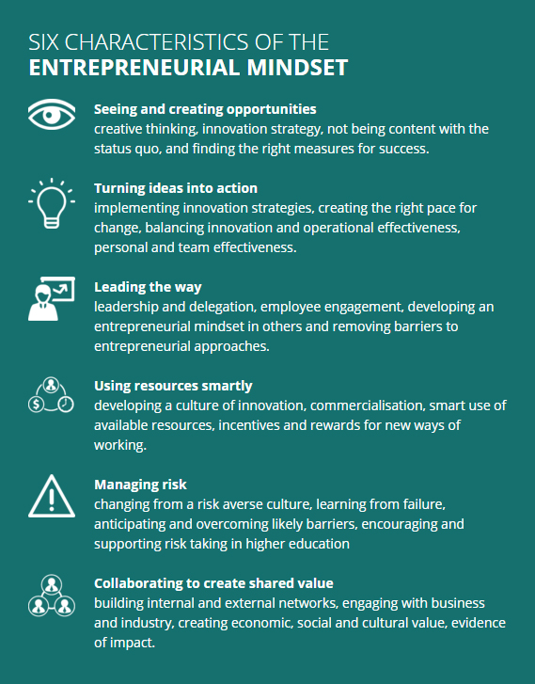

Slide 23
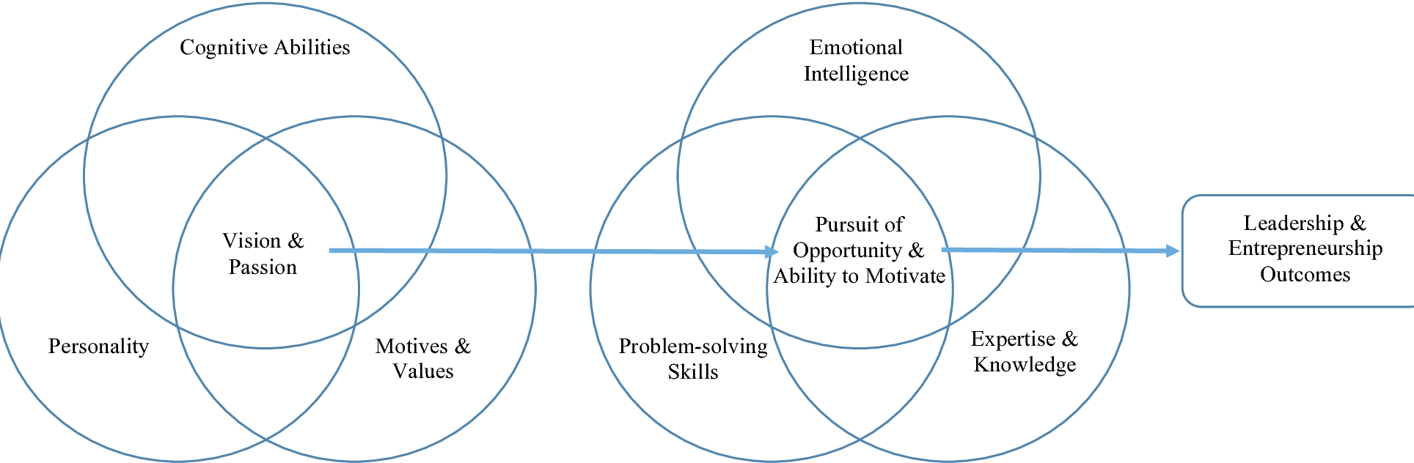

Slide 24
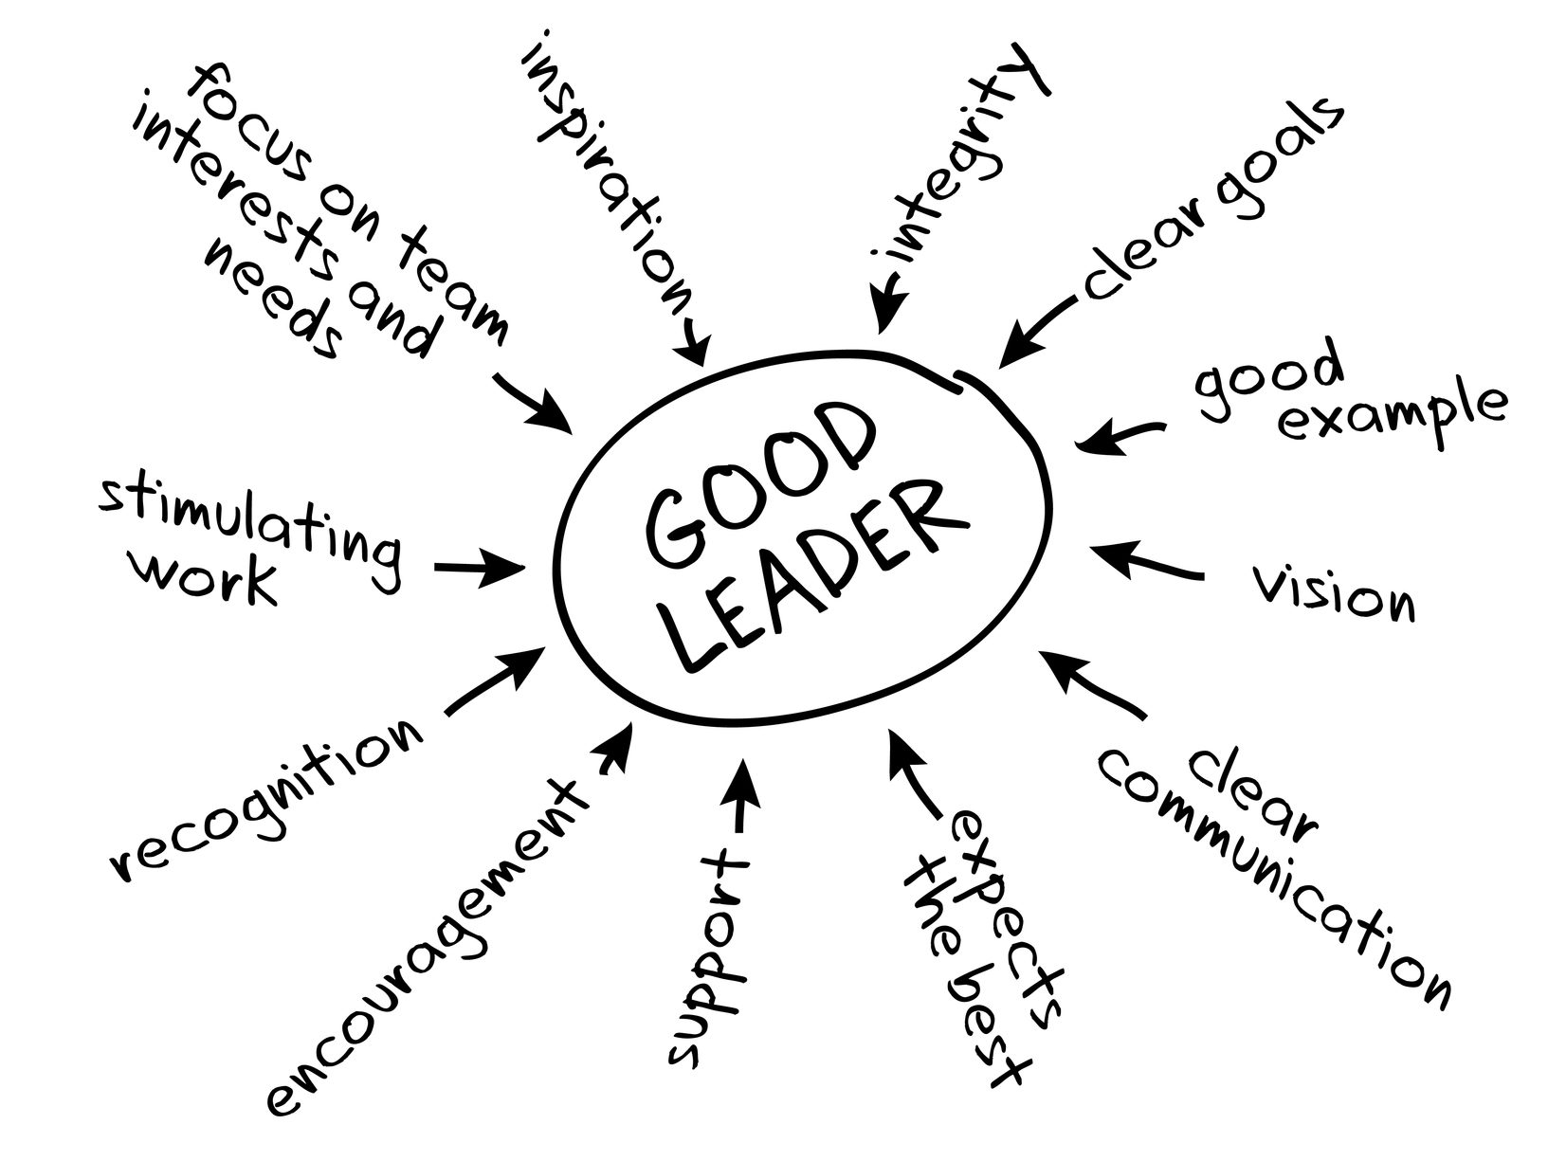

Slide 25
Hare and tortoise story
https://drive.google.com/file/d/1Xde7txNIlY9VzgfxZVXR5kinpKxb7D_P/view?usp=sharing

Slide 26
Types of enterprise and ownership structure
https://www.fool.com/the-blueprint/types-of-business-ownership/
Book_Schemes for MSMEs_of GOI - https://drive.google.com/file/d/1H__Bq6qgAkaVLuvplP1wyR7Jf9KiGgeL/view?usp=sharing
https://www.open.edu/openlearn/money-business/business-strategy-studies/different-types-business/content-section-4
https://www.livecareer.com/resources/careers/planning/business-ownership
https://thebusinessprofessor.com/business-governance/sole-proprietorship-a-detailed-explanation
LLP - https://www.addressadda.com/all-registered-llp-firms-in-india.php
LLc - https://www.upcounsel.com/well-known-llc-companies
https://www.offshorecompany.com/company/india-llc/
http://www.esupportkpo.com/images/Learning%20Pages%20-%20Articles%20-%20Types%20of%20Business%20Structures%20in%20India.pdf
https://www.ahlawatassociates.com/blog/types-of-business-structures-in-india/

Slide 27
Self Learning activities of this week - 03-08-2021
Notes on MSMEs - Micro, Small, Medium Enterprise structure along with the schemes offered by GOI

Slide 28


Slide 29
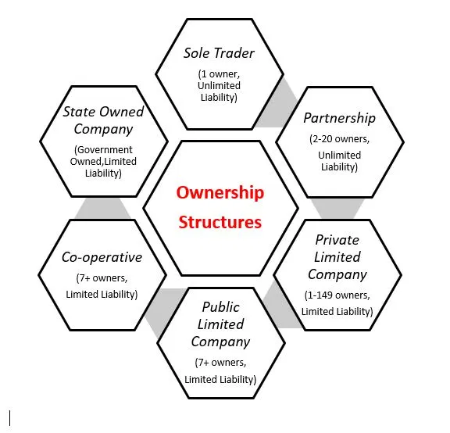
Types of enterprise and ownership structure
Based on
No of owner
Control over the business
Taxation
Liability
Finance
Legal status
Profit and loss
Risk

Slide 30
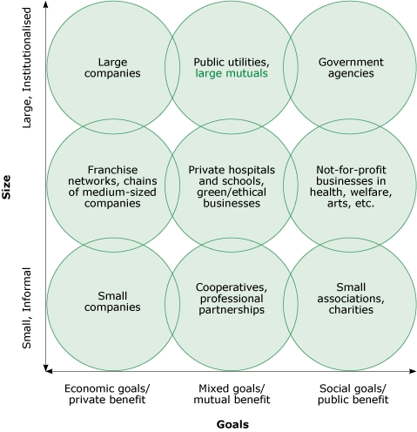

Slide 31
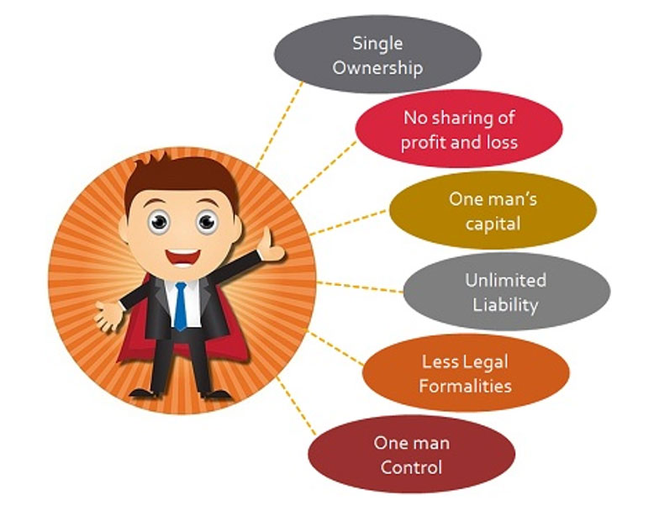
Sole Proprietorship
Based on
No of owner
Control over the business
Taxation
Liability
Finance
Legal status
Profit and loss
Risk

Slide 32
1. Sole Proprietorship
default structure of a business that hasn’t filed any paperwork to create a legal entity.
It is the simplest form of business ownership, and
the structure of choice for four out of five small business owners with no employees.
Advantages of a sole proprietorship
Sole proprietorship is a simple ownership type with several advantages, including the following:
Simplicity:
In most cases, sole proprietors operating under their own names can simply get to work without filing paperwork with the state.
Sole proprietorships may be exempt from certain licensing and registration requirements such as obtaining a business license to sell online.
This makes sole proprietorship the simplest and least expensive among the different types of business ownership.
Control over the business:
A sole proprietorship is owned by a single person.
There’s no need to get consensus before making decisions about the business: It’s all yours.
Pass-through taxation:
Profits from a sole proprietorship pass through to the owner’s personal income, simplifying taxes significantly.

Slide 33
1. Sole Proprietorship
Disadvantages of a sole proprietorship
Sole proprietorships do have their disadvantages compared to other types of ownership.
Legal liability:
A sole proprietorship passes more than income through to its owner.
Legally, the two are inseparable.
That means any lawsuits or other claims against the business are launched personally against the owner.
As a sole proprietor, you’re putting your personal assets on the line every day that you operate your business.
Financial risk:
In addition to legal risks, sole proprietors take on all financial risk of the business personally.
Your home, bank accounts, cars, and other assets can be seized to satisfy claims by creditors if your business hits a rough patch financially.
Access to funding:
Because of their informal structures, sole proprietorships generally have a harder time accessing loans and investment capital than other business ownership types.
This can make it difficult to provide competitive benefits such as small business health insurance.

Slide 34
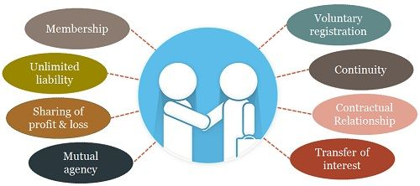
Partnership
https://businessjargons.com/partnership.html

Slide 35
2. Partnerships
Partnerships, often called general partnerships, are businesses with more than one owner.
If you team up on a business venture without forming a legal business entity through the state, your business is a partnership by default.
While they don’t require formation paperwork, there may be limitations on naming a partnership in your state, which may necessitate filing a “doing business as” (DBA) name.
Partnerships are usually founded on formal partnership agreements outlining the ownership share, rights, and obligations of each partner.
Partnerships are a popular type of company ownership for professional firms.

Slide 36
2. Partnerships
Advantages of a partnership
Partnerships provide some notable advantages, including:
Simplicity: Partnership is a relatively simple structure since it doesn’t require formation paperwork. Depending on the number of partners and the terms of your agreement, they can also be relatively simple to run.
Pass-through taxation: Partnerships are pass-through entities, with income passing through to partners proportionally based on share of ownership. If your partnership is split evenly down the middle, for example, 50% of the business’s profits would pass through to each partner’s personal income. Partnerships qualify for the 20% QBI deduction.
Control over the business: Partnerships allow their owners to participate in the business directly and allocate profits and control according to their own wishes. New partners can be brought in relatively easily.

Slide 37
Disadvantages of a partnership
Following are some drawbacks of partnerships:
Legal liability: Like sole proprietorships, partnerships open the partners up to legal liability for the firm’s operations. Liability insurance can address these risks, but insurance has limits.
Financial risk: Partners also take on financial liability for the business, putting their personal assets at risk in case of financial hardship or bankruptcy.

Slide 38
Public limited Co.
https://www.fundoodata.com/learning-center/top-10-public-limited-companies-india/
A Public Limited Company under Company Act 2013 is a company that has limited liability and offers shares to the general public.
Its stock can be acquired by anyone, either privately through (IPO) initial public offering or via trades on the stock market.

Slide 39
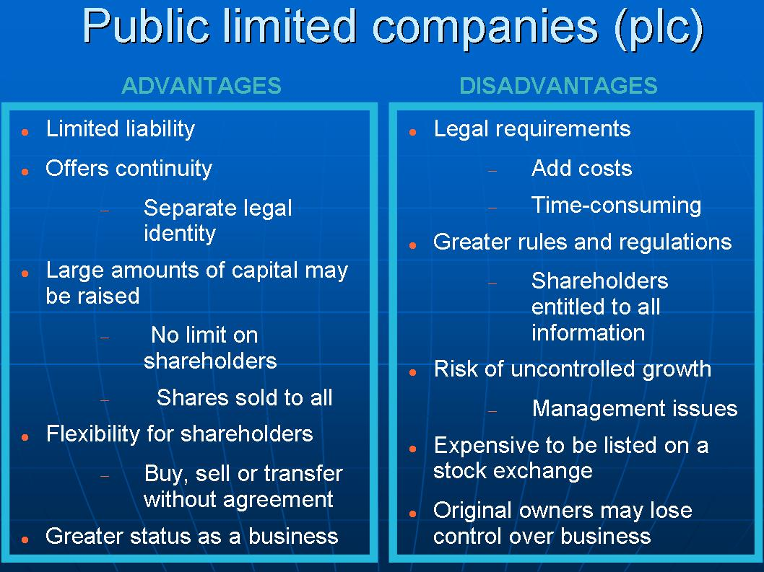
Additional Information :
https://www.informdirect.co.uk/company-formation/public-limited-company-advantages-disadvantages/

Slide 40
Private limited companies
https://www.fundoodata.com/learning-center/top-10-private-limited-companies-india/
A Private Limited Company is formed lawfully with Limited Liability or Legal Protection for its shareholders but that places restrictions on its ownership.
A private limited company is a privately-held business entity.
It is held by private stakeholders.
The liability arrangement in these is that of a limited partnership, wherein the liability of a shareholder extends only up to the number of shares held by them.
Private Limited Company is the simplest and a very popular form of Business Registration in India.
It can be registered with a minimum of two people.
Following points make it the most recommended type of business entity for millions of small and medium-sized businesses that are family owned or professionally managed.
Limited liability protection to shareholders,
ability to raise equity funds,
separate legal entity status

Slide 41
Minimum Requirement for Private Limited Company
A minimum number of two Directors who are adults.
One of the Directors of a Private Limited Company has to be an Indian Citizen and Indian Resident.
The other Director(s) can be a Foreign National.
It is also required to have two Shareholders of a company.
The Shareholders can be natural persons or an artificial legal entity.

Slide 42
Advantages of Private Limited Company
No Minimum Capital
No minimum capital is required to form a Private Limited Company. A Private Limited Company can be registered with a mere sum of Rs. 10,000 as total Authorized Share capital.
Separate Legal Entity
A Private Limited Company is a separate legal identity in the court of the law, meaning assets and liabilities of the business are not the same as the assets and liabilities of the Directors. Both are counted as different. A Private Limited Company separates Management and Ownership and thus, managers are responsible for the company’s success and are also answerable for the company’s loss.
Limited Liability
If the company undergoes financial distress because of whatsoever reasons, the personal assets of members will not be used to pay the debts of the Company as the liability of the person is limited.
For e.g. If a Private Limited Company takes any loan and is unable to pay off, the members are responsible to pay only that much how much they own towards their own shareholding i.e. the unpaid share value. Which means, if you have no balance payable towards the amount of shares you hold, you are not payable towards any debt payable by the company even if the debt/credit amount remains unpaid.
Fund Raising
A Private Limited Company in India is the only form of business except Public Limited Companies that can raise funds from the Venture Capitalists or Angel investors.

Slide 43
Free & Easy transfer of shares
Shares of a company limited by shares are transferable by a shareholder at any other person. The transfer is easy as compared to the transfer of an interest in a business run as a proprietary concern or a partnership. Filing and signing a share transfer form and handing over the buyer of the shares along with share certificate can easily transfer shares.
Uninterrupted existence
A Private Limited Company has ‘Perpetual Succession’, that is continued or uninterrupted existence until it is legally dissolved. A company, being a separate legal person, is unaffected by the death or other departure of any member but continues to be in existence irrespective of the changes in membership. ‘Perpetual Succession’ is one of the most important characteristics of a company.
FDI Allowed
In Private Limited Company, 100% Foreign Direct Investment is allowed that means any foreign entity or foreign person can directly invest in a Private Limited Company.
Builds Credibility
The particulars of the company are available on a public database. Which improves the credibility of the company as it makes it easy to authenticate the details
Disadvantages of a Private Limited Company
One of the main disadvantages of a Private Limited Company is that it restricts the transfer ability of shares by its articles.
In a Private Limited Company the number of shareholders in any case cannot exceed 50.
Another disadvantage of Private Limited Company is that it cannot issue prospectus to public.
In stock exchange shares cannot be quoted

Slide 44
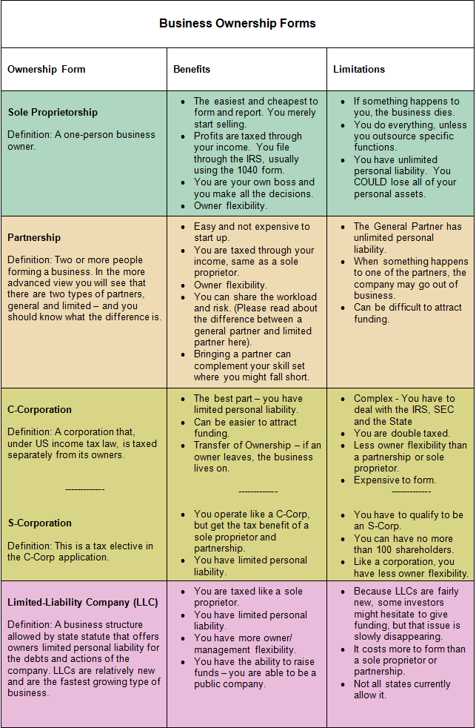

Slide 45
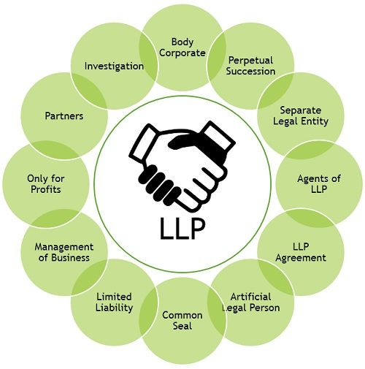
LLP - Limited Liability Partnership

Slide 46
3. Limited Liability Partnership (LLP)
An LLP is a legal entity available in some states to provide the simplicity and pass-through taxation of a partnership while limiting liability for the partners.
In addition to a formal operating agreement among partners, LLPs generally require registration with the secretary of state.
Where available, they are a popular type of business entity with professionals such as doctors, lawyers, accountants, architects, and engineers.

Slide 47
Advantages of an LLP
LLPs provide their owners with many advantages, including:
Limited liability:
Like an LLC, an LLP is a separate legal entity with its own assets and obligations.
This protects partners from personal liability for legal and financial claims against the firm, although the degree of protection varies by state.
Generally, the partners’ liability is limited to their investments in the firm.
Partners may still be liable for their own personal errors and misconduct, so liability insurance is generally still required.
Ownership and control: Like partnerships, LLPs allow owners to actively participate in the business and control how it is run.
Tax options: LLPs may be considered pass-through entities, which can be advantageous for owners, particularly with the 20% QBI deduction. Their tax treatment varies by state, however.

Slide 48
Disadvantages of an LLP
Some limitations of LLPs include:
Limited availability:
LLPs are not available in every state, and they may only be available to certain types of businesses.
Increased complexity:
Because LLPs are treated differently in different states, partners will need to research their state requirements and tax laws thoroughly before choosing this structure.

Slide 49
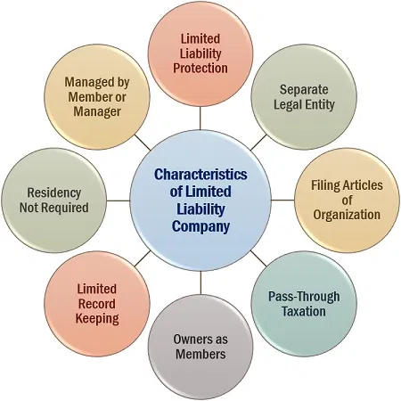
LLC

Slide 50
4. Limited Liability Company (LLC)
An LLC is a legal entity formed by creating an LLC operating agreement and filing articles of organization with the secretary of state.
LLCs allow business owners to retain some of the advantages of sole proprietorship
while limiting legal and financial liability,
making them a popular business ownership structure for small businesses.

Slide 51
Advantages of an LLC
Limited liability is one of several benefits provided by an LLC:
Limited liability:
When you form an LLC, you create a separate legal entity with its own assets and obligations.
Any legal claims against the business remain against the business, not its owners.
Members of an LLC may still be liable for their personal conduct, however, so liability insurance is generally advised.
Active ownership:
LLCs allow ownership by two or more members who can exert as much control and involvement in the business as they like.
Tax options:
LLCs are pass-through entities, which can be advantageous for owners, particularly with the 20% QBI deduction.
But LLCs also provide additional flexibility by allowing members to choose to be taxed as a corporation instead (see “corporations,” below).
This is generally advantageous to larger firms, but it gives LLCs flexibility as the business grows.

Slide 52
Disadvantages of an LLC
Following are some of the limitations of LLCs:
Complexity:
LLCs must be formed by filing articles of formation with the state.
You also have ongoing regulatory paperwork to attend to, including maintaining a registered agent to receive legal documents and filing periodic reports where required with the state.
All of this adds up to extra administrative time and complexity.
Administrative costs:
An LLC costs more to create and maintain than a sole proprietorship.
State filings generally require fees, and you may need software or support to complete them.
You may need extra legal and financial guidance to ensure that you’re getting the most out of your choices as well, which can further add to the costs.

Slide 53
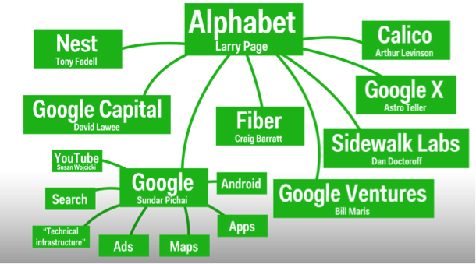
Series LLC
Alphabet Inc. is an American multinational conglomerate headquartered in Mountain View, California.
It was created through a restructuring of Google on October 2, 2015, and became the parent company of Google and several former Google subsidiaries.

Slide 54
5. Series LLC
Currently available in 18 states and counting, series LLCs are an up-and-coming type of business ownership structure.
Basically, they allow one parent LLC to form multiple internal LLCs in subsidiary fashion.
These nested LLCs can be used to isolate liability for different business units.
Series LLCs are complex, but worth discussing with your advisors if your business has distinct units that might benefit from individual treatment.
https://en.wikipedia.org/wiki/Series_LLC

Slide 55
Advantages of a series LLC
Series LLCs provide numerous benefits, including:
Really limited liability: Each LLC within a series has separate members, assets, and liabilities.
Active ownership: Series LLCs allow owners to actively participate in the operation of their individual LLCs.
Tax options: Series LLCs retain the tax advantages and flexibility of traditional LLCs.
Unified filing: Despite the multiple LLCs, a series LLC is required to register and file taxes just once through the parent LLC.
The registrations and returns must encompass all LLCs, however, so they are still more complicated than a single LLC.

Slide 56
Disadvantages of a series LLC
Series LLCs have the following limitations:
Complexity:
Despite the unified filing setup, it’s considerably more complex to manage multiple LLCs with separate assets and owners than a single entity.
Taxes in particular are complicated by the series structure.
Administrative costs:
The added administrative burden means additional cost and guidance from professional advisors.
In addition, fees may be higher for forming a series LLC.

Slide 57
6. C Corporation
A corporation is owned by shareholders who may have varying levels of control and involvement in the everyday operations of the business.
In the case of stock corporations, ownership is issued in shares of stock.
A corporation is formed by filing articles of incorporation with the state.
The process of incorporation includes appointing a board of directors to oversee the business and establishing bylaws for its governance.
With governance managed through a board of directors and ownership distributed among shareholders, corporations represent a further degree of separation between the business entity and its owners.
Unlike sole proprietorships, partnerships, and LLCs, C corporations are not pass-through entities.
Profits belong to the corporation and are subject to corporate income tax. They may also be distributed through dividends to shareholders.

Slide 58
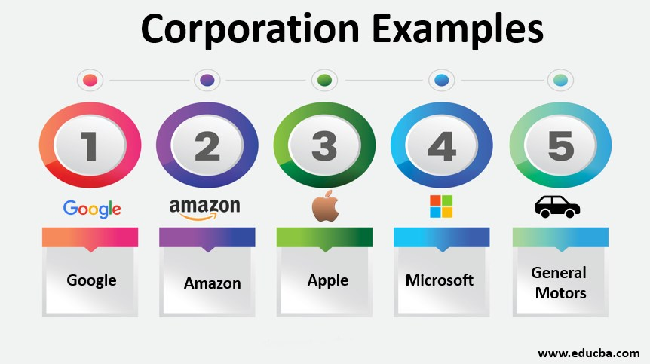

Slide 59
Advantages of a C corporation
With their formal governance and ownership structures, corporations can sustain any level of growth. Generally, the structure becomes advantageous as a business grows larger. Some of the advantages include the following:
Limited liability:
Like an LLC, a corporation is a separate legal entity with assets and liabilities of its own.
The liability of its shareholders is generally limited to the amount they have invested in the business.
Self-employment taxes:
Shareholders who work in the business are paid and taxed as employees, sparing them from self-employment tax.
Income can be kept in the business as equity and distributed through shares and dividends, providing greater financial flexibility.
Access to capital:
C Corporations can access capital by issuing stock.
They can make unlimited stock offers to individuals or businesses, including foreign or domestic investors. They can also issue multiple types of stock.

Slide 60
Disadvantages of a C corporation
Incorporation also has the following drawbacks:
Regulatory oversight: Corporations are subject to greater scrutiny than LLCs, being required to disclose earnings, governing documents, and other information annually to shareholders and in some cases the public.
Corporate tax:
The profits of C corporations are subject to corporate tax.
Shareholders who work in the business and take a salary, as well as shareholders who earn dividends, also pay personal income tax on their earnings.
This results in two layers of taxation on the business’s profits.
Complexity and costs: Corporations are more complex and costly to form and maintain than other business entities.
Less control: Because ownership is spread among shareholders, and governance among a board of directors, corporations make it harder to exert individual control over the business.

Slide 61
7. S Corporation
Some corporations can enjoy the benefits of pass-through taxation by electing to be taxed as an S corporation.
To qualify, the corporation may not have more than 100 shareholders and may issue only one class of stock.
Only individuals, certain estates and trusts, and certain tax-exempt organizations may own shares in an S corporation.
An S corporation is formed through the same steps as a C corporation, with an additional election made through a filing with the Internal Revenue Service.

Slide 62
Advantages of an S corporation
The advantages of an S corporation include:
Limited liability: Like all corporations, S corporations limit the owners’ personal liability for the business’s debts and legal obligations.
Access to funding: S corporations can attract investment capital and other funding.
Pass-through taxation: S corporations qualify for pass-through taxation, which can reduce the tax burden for individual shareholders as well as for the business.
Disadvantages of an S corporation
Some of the drawbacks of S corporations include the following:
Higher startup costs: Like any corporation, S corporations cost more to start and operate than LLCs and sole proprietorships.
Increased complexity: S corporations must regularly report earnings and other information to shareholders.
Limits on ownership: S corporations may be owned only by individuals who are U.S. citizens or residents, and they can issue only one type of stock.

Slide 63
8. Nonprofit Corporation - https://en.wikipedia.org/wiki/Category:Non-profit_organisations_based_in_India
Most nonprofits are formed as corporations that apply for tax-exempt status under Section 501(c) of the IRC.
Their entity formation process is the same as that of other corporations, with articles of incorporation filed with the secretary of state, a board of directors, and bylaws for governance.
Nonprofits may be formed solely for the tax-exempt purposes specified in Section 501(c), however, and they are subject to specific regulatory requirements in each state.
Contrary to popular belief, nonprofits can and should generate profits.
The difference between a nonprofit entity and a for-profit entity is how those profits are invested.
Rather than being distributed to shareholders, profits are reinvested in the nonprofit’s operations to serve its charitable mission.

Slide 64
Advantages of a nonprofit corporation
Nonprofit corporations provide significant advantages, including:
Liability protection: Nonprofit corporations provide the same limits on liability as other corporations, protecting you from personal liability for the nonprofit’s operations.
Tax exemption: Nonprofits may qualify for exemption from federal taxes as well as many state and local taxes. This allows nonprofits to stretch their budgets and apply maximum resources toward their missions. Federal tax exemption is not a blanket exemption from all taxes, however. Nonprofits that achieve federal tax-exempt status generally need to apply separately for exemption from state and local taxes such as sales tax.
Disadvantages of a nonprofit corporation
Some of the limitations of nonprofit corporations include the following:
Limited activities: Nonprofits must limit their activities to the pursuit of charitable purposes.
Limited access to funding: Nonprofit organizations rely on grants and charitable contributions to fund their operations.
Increased regulatory oversight: In addition to the usual duties of corporations, nonprofits have unique registration and reporting requirements to manage at the state and federal levels.

Slide 65
9. Benefit corporation
Benefit corporations are corporations formed to serve a public benefit in addition to the usual corporate mission of earning profits.
They are structured like other corporations with a board of directors and bylaws, yet the board is responsible for measuring and reporting on its social impact as well its financial performance.
Benefit corporations are an increasingly popular structure for entrepreneurs who want to do good while doing business.
Advantages of a benefit corporation
Benefit corporations provide the following advantages:
Limited liability: Like any other corporation, a benefit corporation limits its shareholders’ liability for financial and legal claims.
Access to funding: Benefit corporations can take advantage of investor capital and revenue from commercial activities to accomplish their social missions.
Profit distribution: Like other corporations, benefit corporations can distribute profits to shareholders as dividends.

Slide 66
Disadvantages of a benefit corporation
Following are some of the drawbacks of a benefit corporation:
Varying regulations: Benefit corporations are currently available in 35 states. This map from B Lab shows where they are available. Each state has its own rules for what types of social benefits qualify and how they must be measured and reported, which means additional complexity in forming and running the business.
Increased regulatory oversight: Benefit corporations must meet all of the usual regulatory requirements of corporations plus report on their social and financial impact annually to shareholders.
Corporate tax: Benefit corporations are subject to federal corporate income tax.

Slide 67
10. Low-Profit Limited Liability Company (L3C)
L3C is a relatively rare business type that combines the legal structure of an LLC with the charitable mission of a nonprofit.
An L3C can distribute modest profits to its members, yet this must always be secondary to the primary purpose of furthering a charitable mission.
L3Cs may not be formed for political or legislative purposes.
L3Cs were conceived as an investment vehicle for foundations, which must give 5% of their assets to a charitable program or program-related investment (PRI) each year.
That plan ran into some hurdles with the IRS, however, and the L3C structure has not been widely adopted as a result.
Advantages of an L3C
An L3C offers some advantages:
Liability protection: L3Cs provide the same limits on liability as LLCs, protecting you from personal liability for the business’s operations.
Flexible ownership: Members of an L3C can maintain ownership and control and actively participate in the day-to-day operations of the business.
Pass-through taxation: L3Cs qualify for pass-through taxation.

Slide 68
Disadvantages of an L3C
Following are limitations of an L3C:
Lack of tax exemption: L3Cs do not qualify for federal tax-exempt status, and are therefore less attractive than incorporation for social enterprises.
Regulatory uncertainty: Because the IRS has not officially sanctioned L3Cs as PRIs for foundations, their usefulness and longevity are uncertain. They are currently permitted in only nine states.

Slide 69
MSMEs
https://sustainabledevelopment.un.org/content/documents/25851MSMEs_and_SDGs_Final3120.pdf
MSME Act - https://drive.google.com/file/d/1Apnvt5fXyA6EarMvRHbYdz4IFeCVQltM/view?usp=sharing
New venture planning - https://notesocean.com/327/unit-2-methods-to-initiate-ventures.html

Slide 70
Self learning
White paper - self learning - https://ncert.nic.in/ncerts/l/lebs213.pdf

Slide 71
https://studylib.net/doc/6864468/forms-of-ownership

